Slide 1
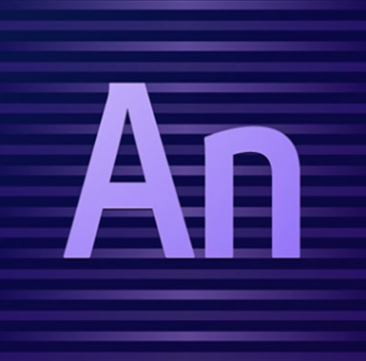
Web Design Fundamentals /
Basic Web Design
ADOBE EDGE ANIMATE CC

Slide 2
Adobe Edge Animate, formerly known as simply Adobe Edge, is a web development tool developed by Adobe Systems that uses HTML5, Javascript, and CSS3 functionality.
Notes:
Just for review….

Slide 3
It is Adobe’s standard solution for creating feature rich and interactive animations for web and mobile devices without code.
Notes:
Just for review….

Slide 4
SKILL REQUIREMENTS
HTML
CSS3
Javascript
Adobe Photoshop
Adobe Illustrator
Adobe Flash (IS A PLUS)

Slide 5
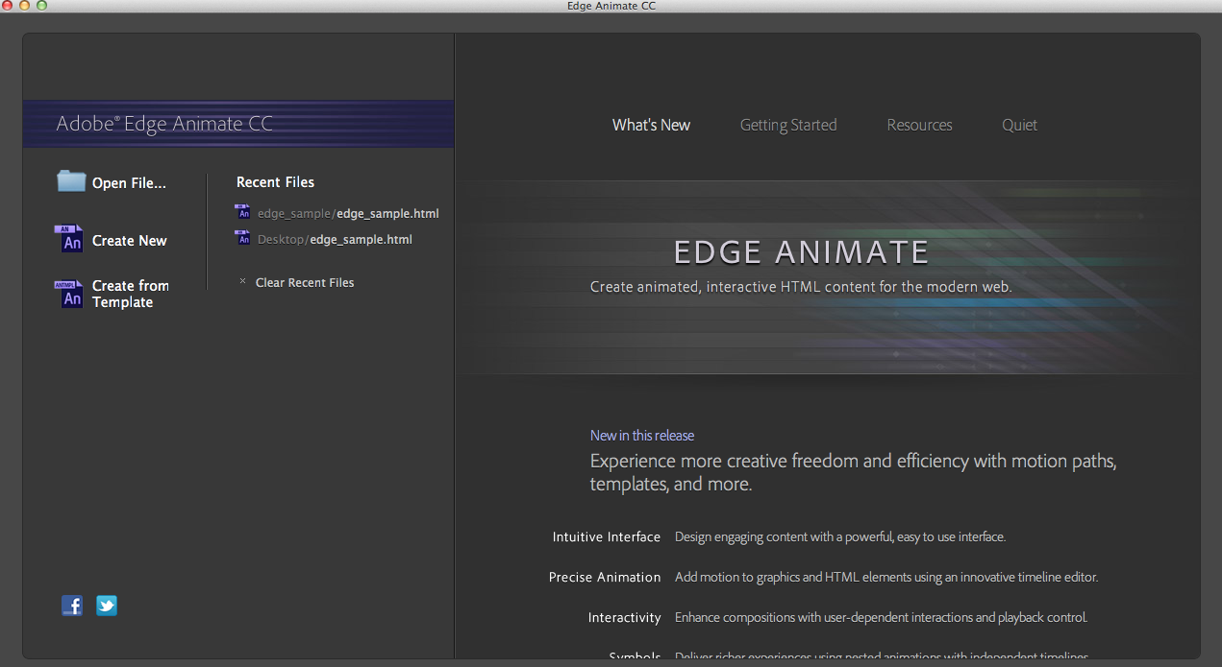
SPLASH SCREEN

Slide 6
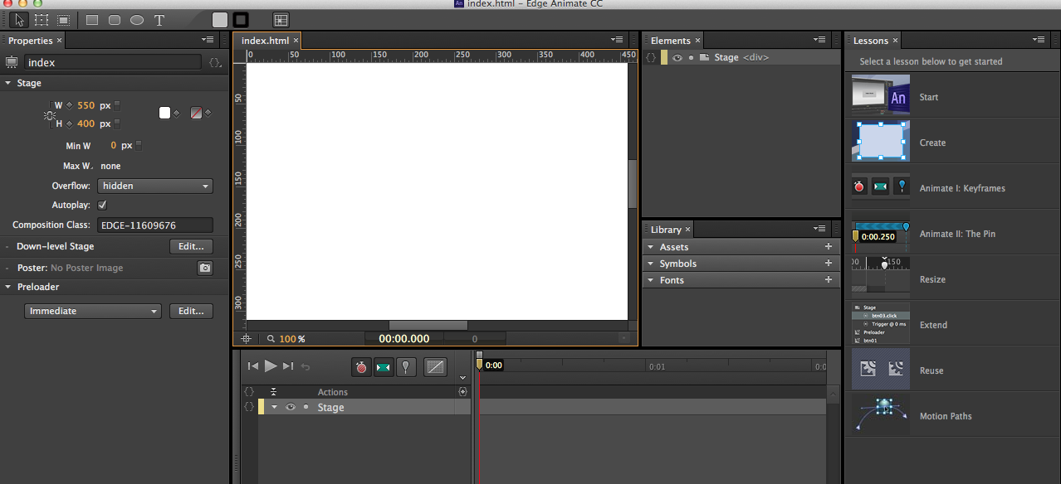
CREATING A NEW PROJECT
Create New
Save the file in a folder

Slide 7
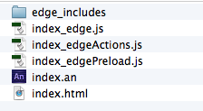
UNDERSTANDING THE FILE STRUCTURE
These files and folders are created and managed by Edge Animate whenever you start and save a project.

Slide 8
DEMO

